Slide 1
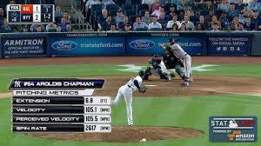
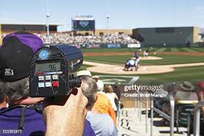
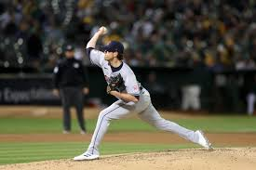
How much does the pitch velocity and type of pitch affect the outcome of each pitch?
Eric, Abhi, and Sam

Slide 2
Variables
pitch_type | release_speed | release_pos_x | release_pos_z | player_name
events | description | balls | strikes | Inning
outs_when_up | plate_x | plate_z | bb_type | Hit location
stand | p_throws | Outs when up

Slide 3
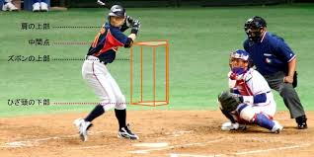

Slide 4
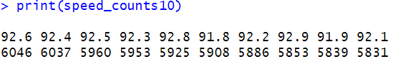
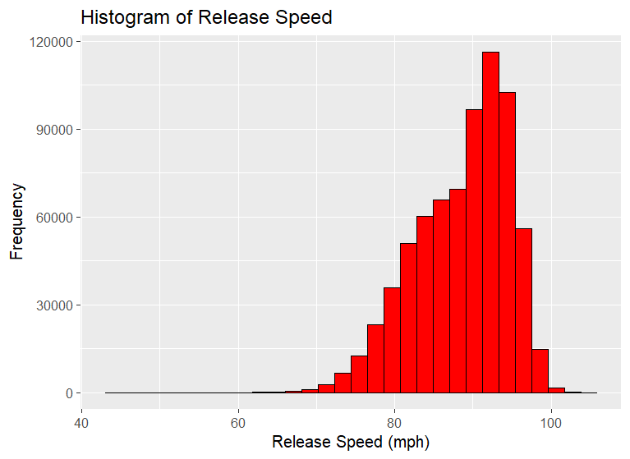

Slide 5
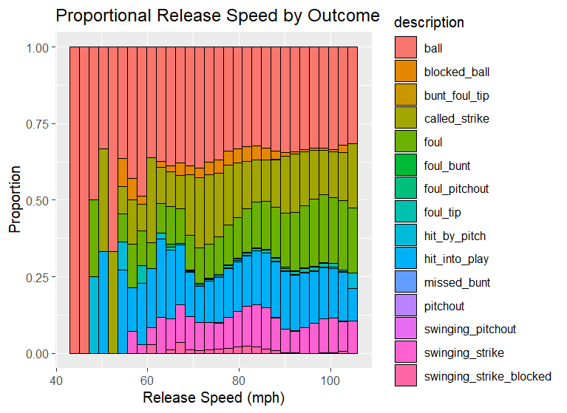
EDA

Slide 6
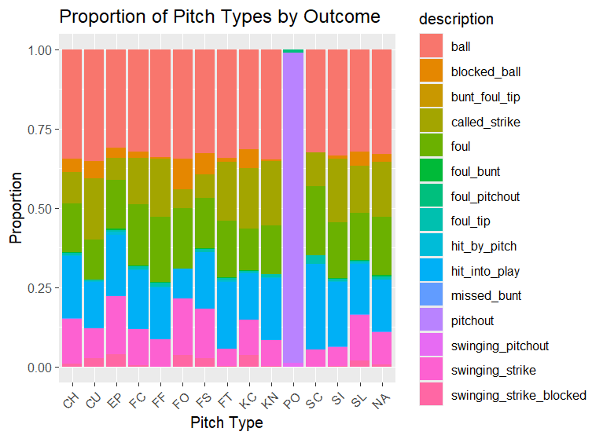
.
.

Slide 7
.
.

Slide 8
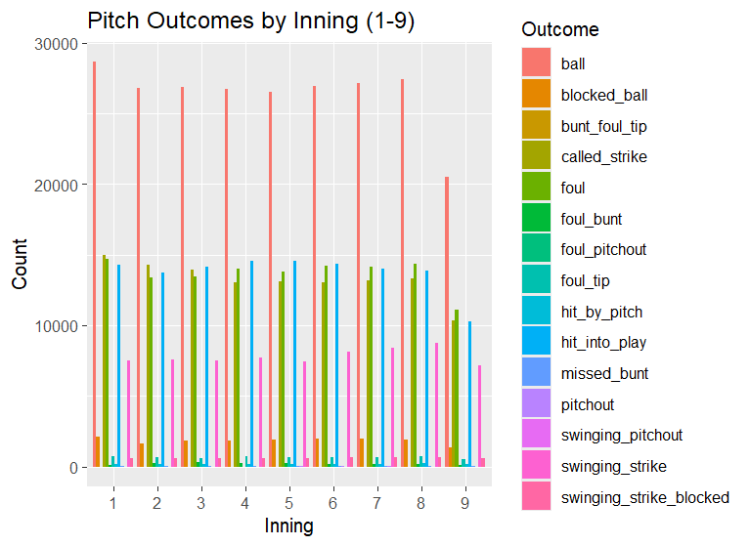
.
.

Slide 9
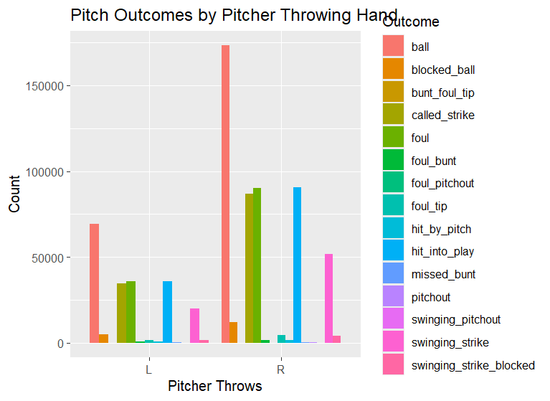
.
.

Slide 10
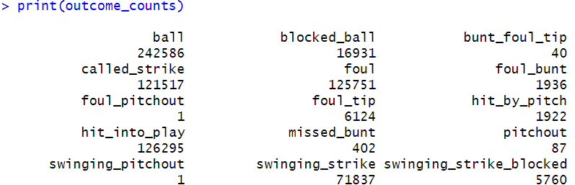
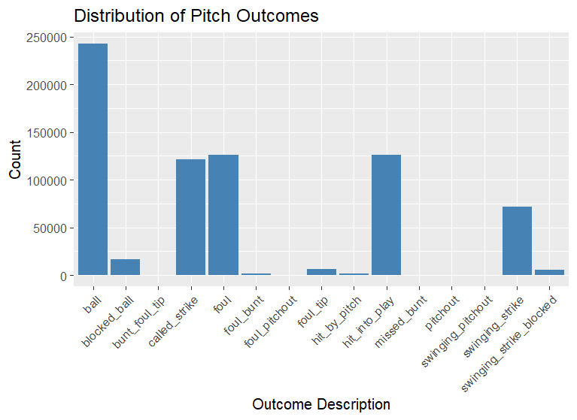
.
.

Slide 11
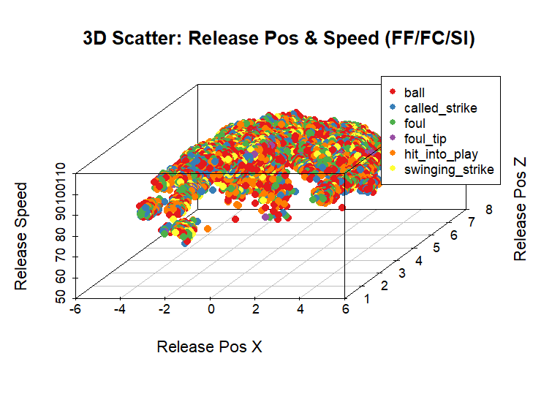

Slide 12
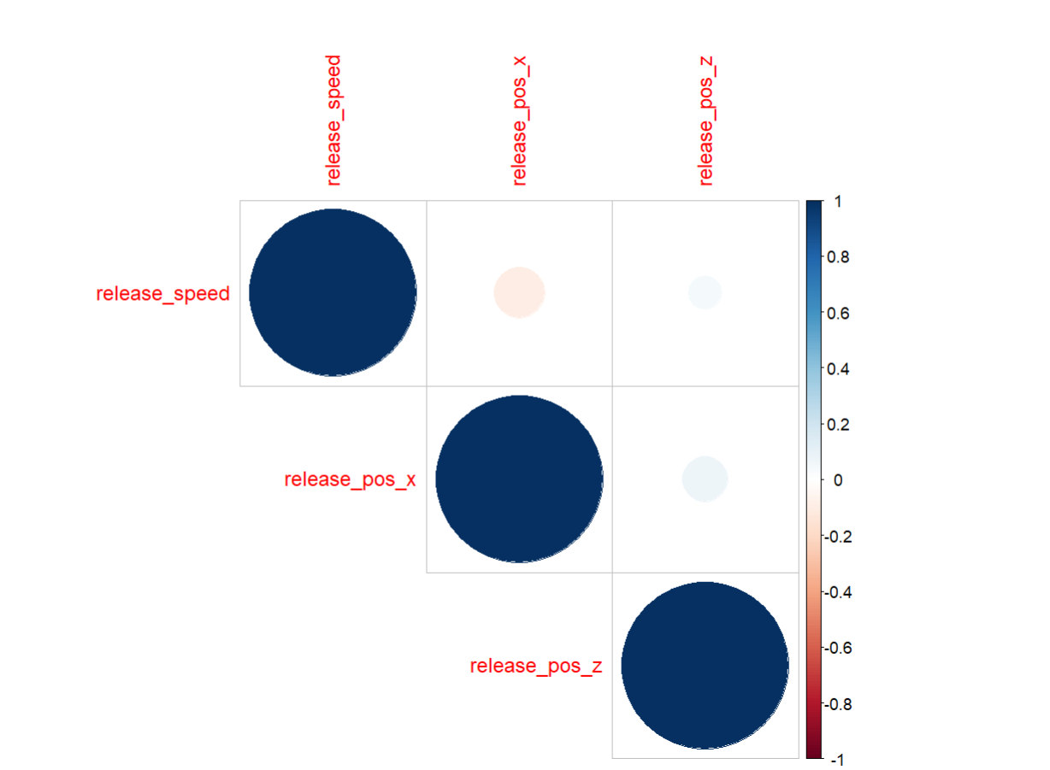
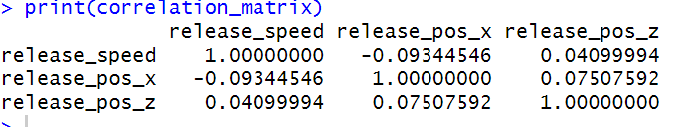
Correlation
.

Slide 13
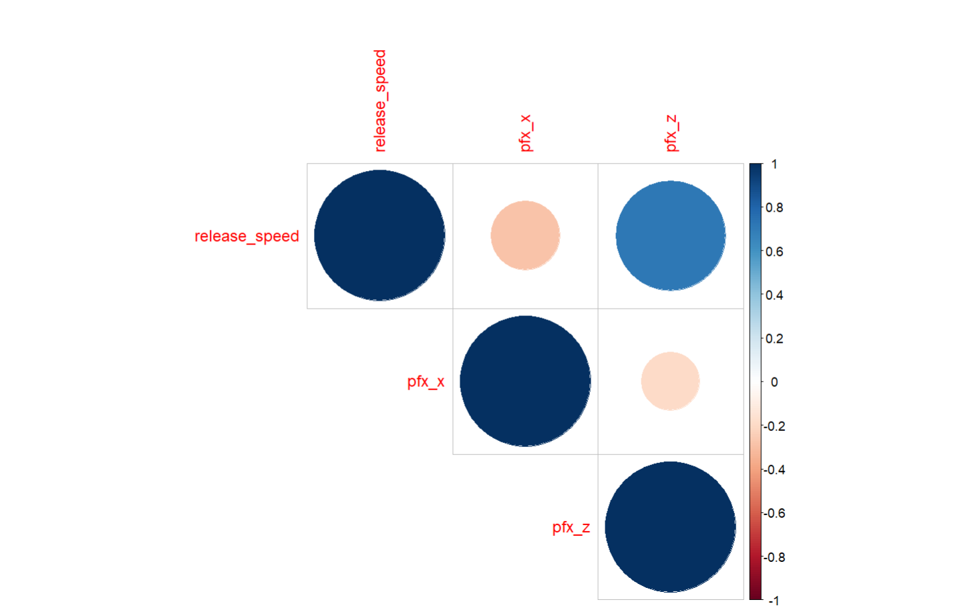
.
.
release_speed pfx_x pfx_z
release_speed 1.0000000 -0.2806151 0.7102167
pfx_x -0.2806151 1.0000000 -0.1996735
pfx_z 0.7102167 -0.1996735 1.0000000

Slide 14
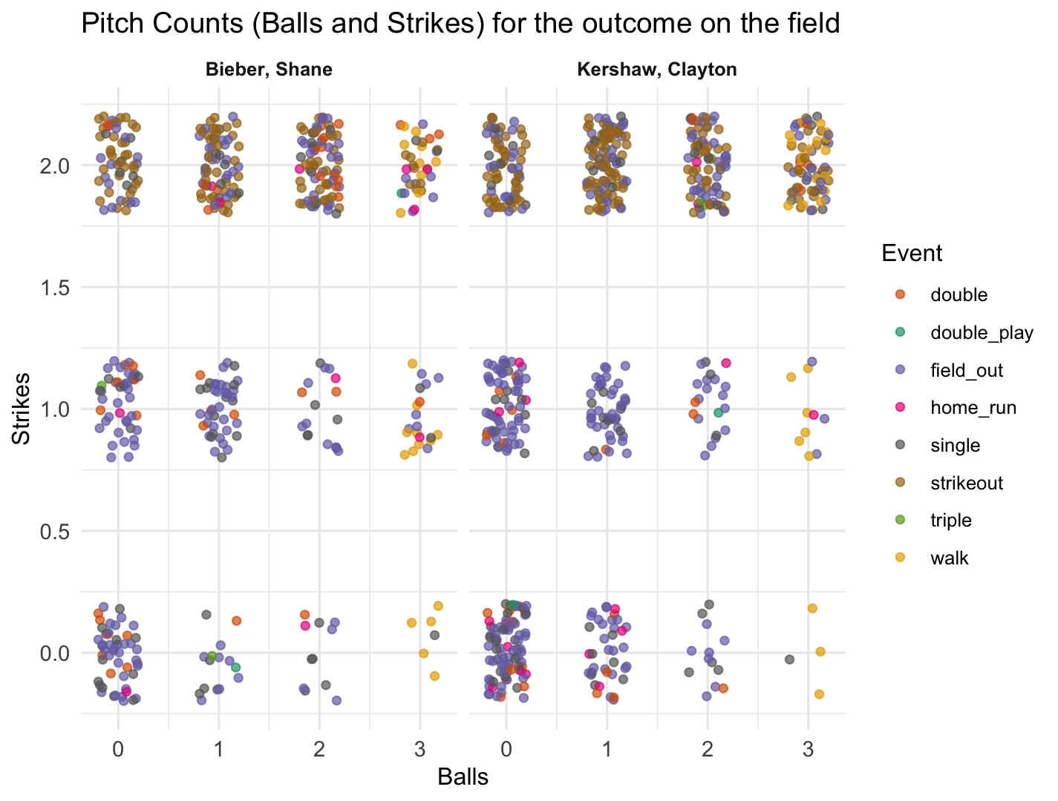

Slide 15
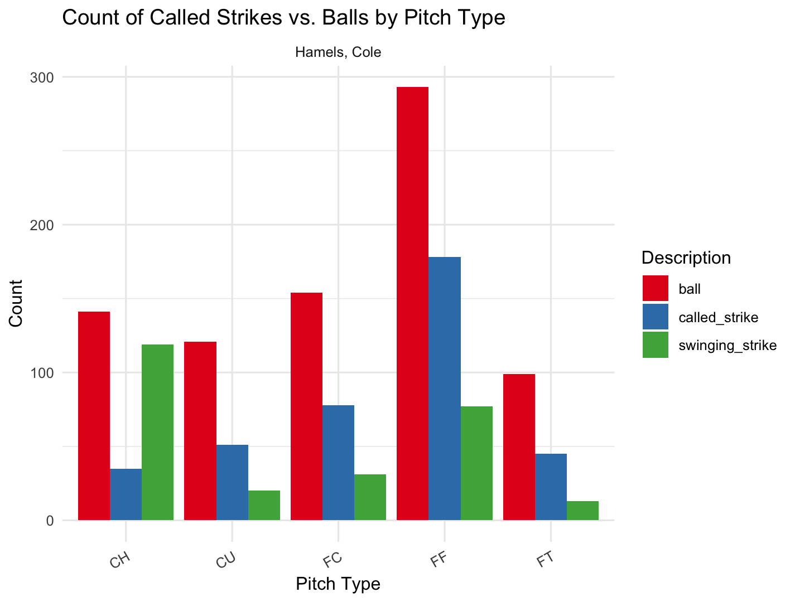

Slide 16


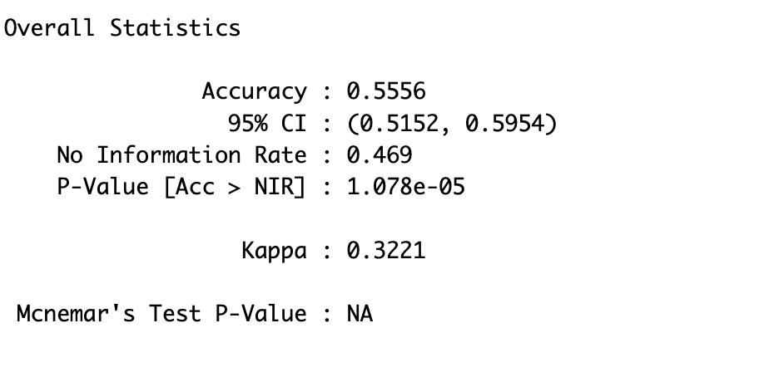
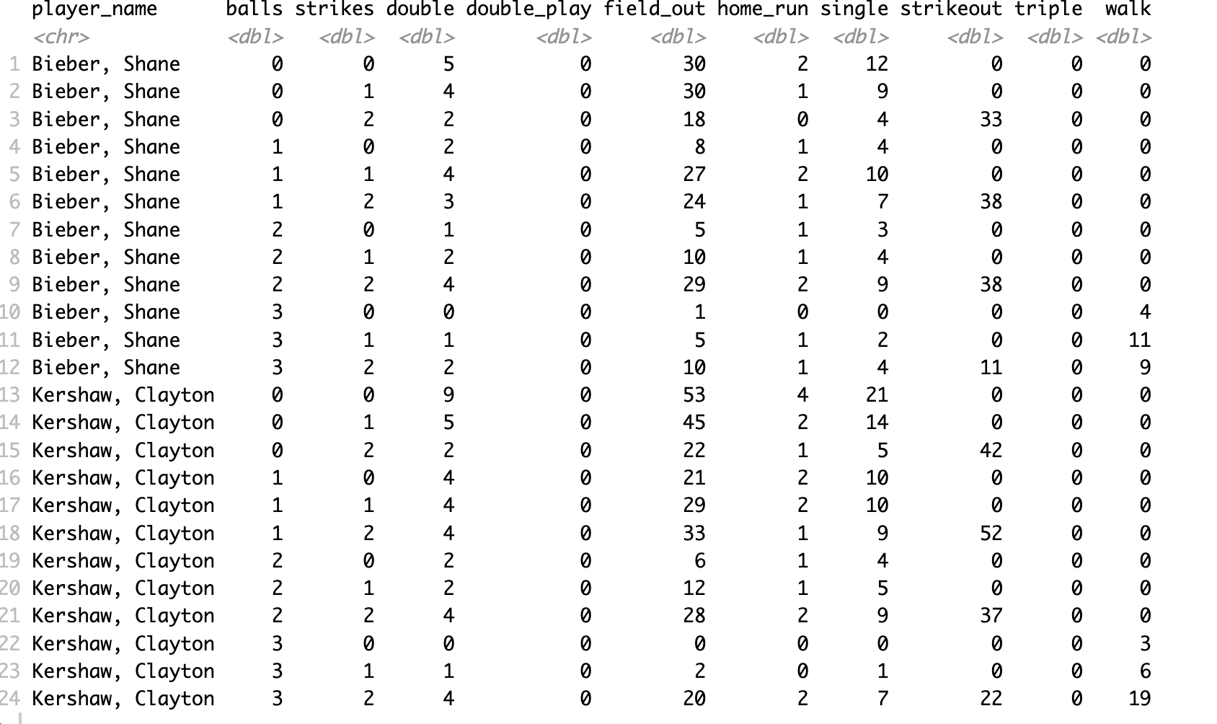
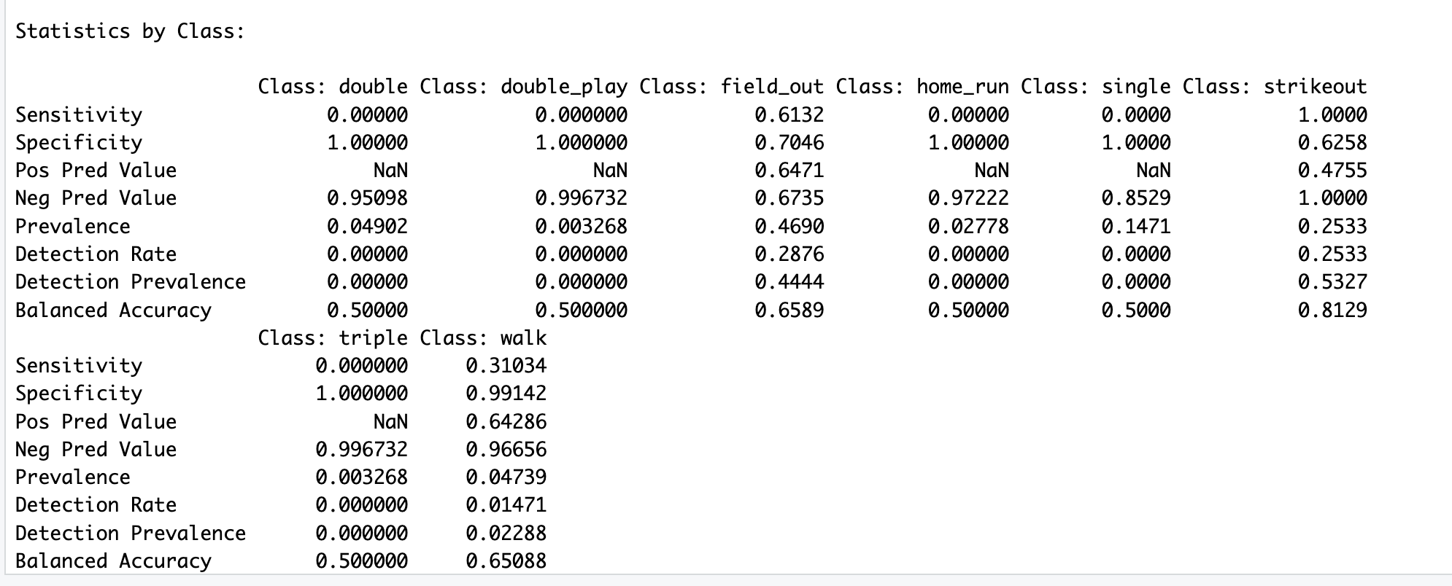
Predictions

Slide 17
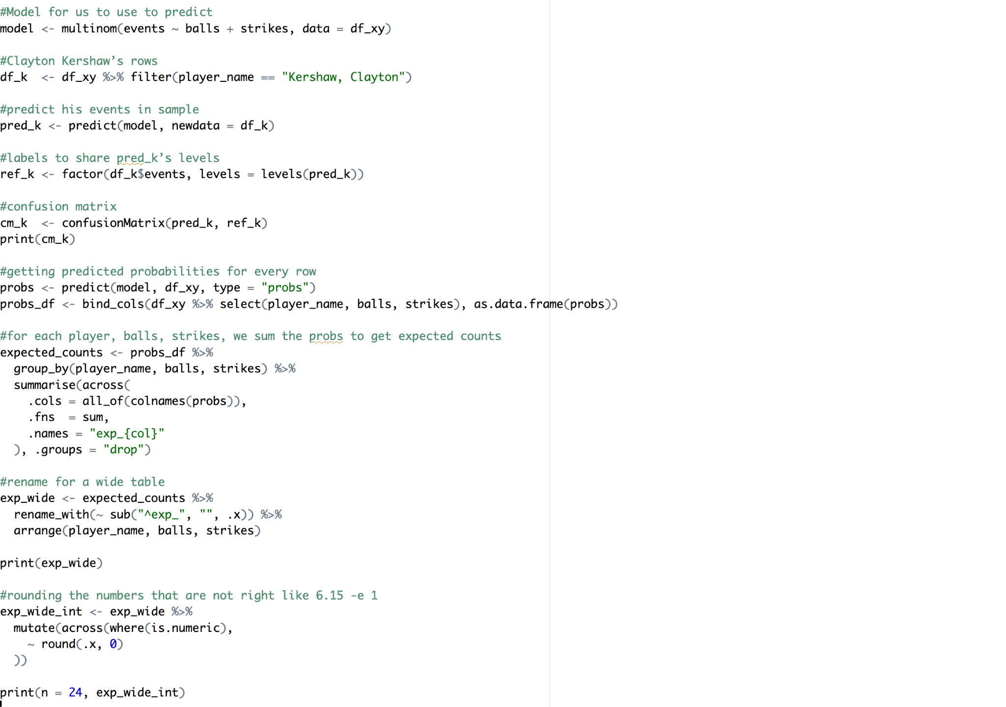

Slide 18

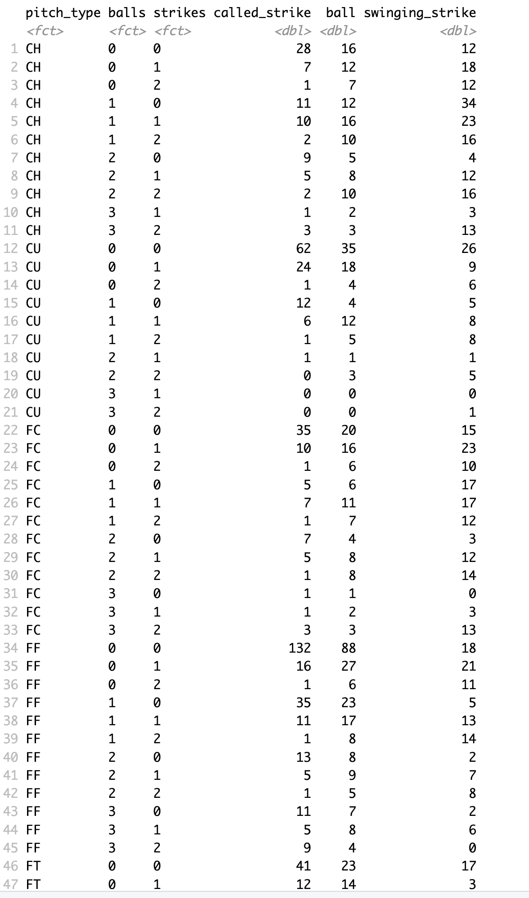
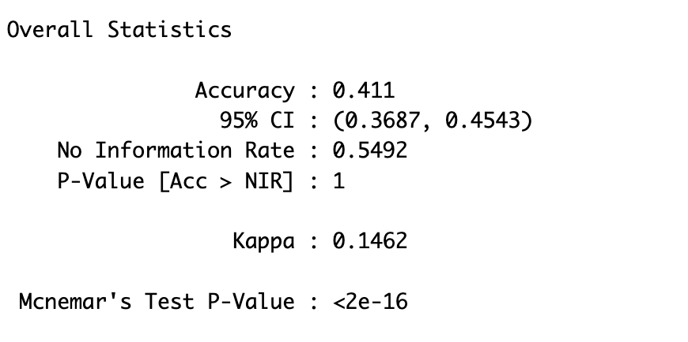
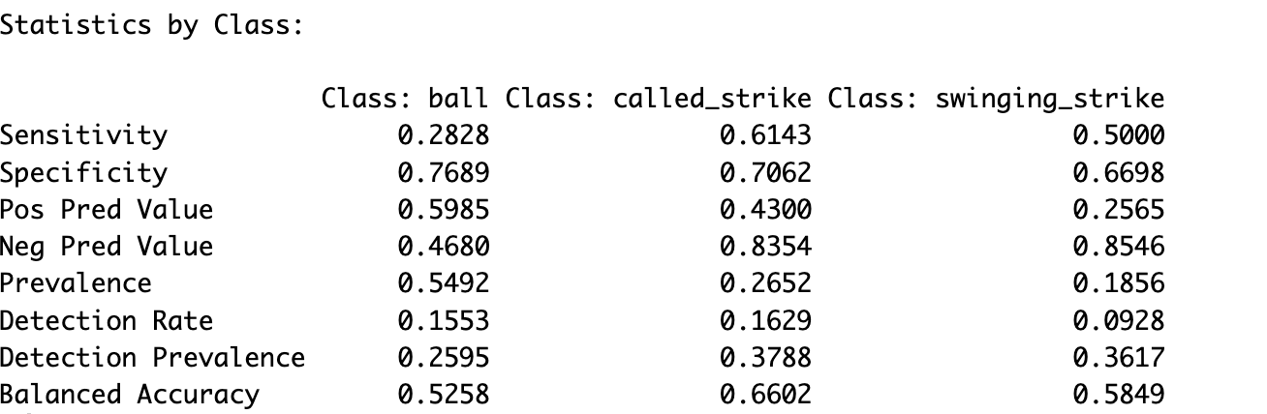
Predictions

Slide 19
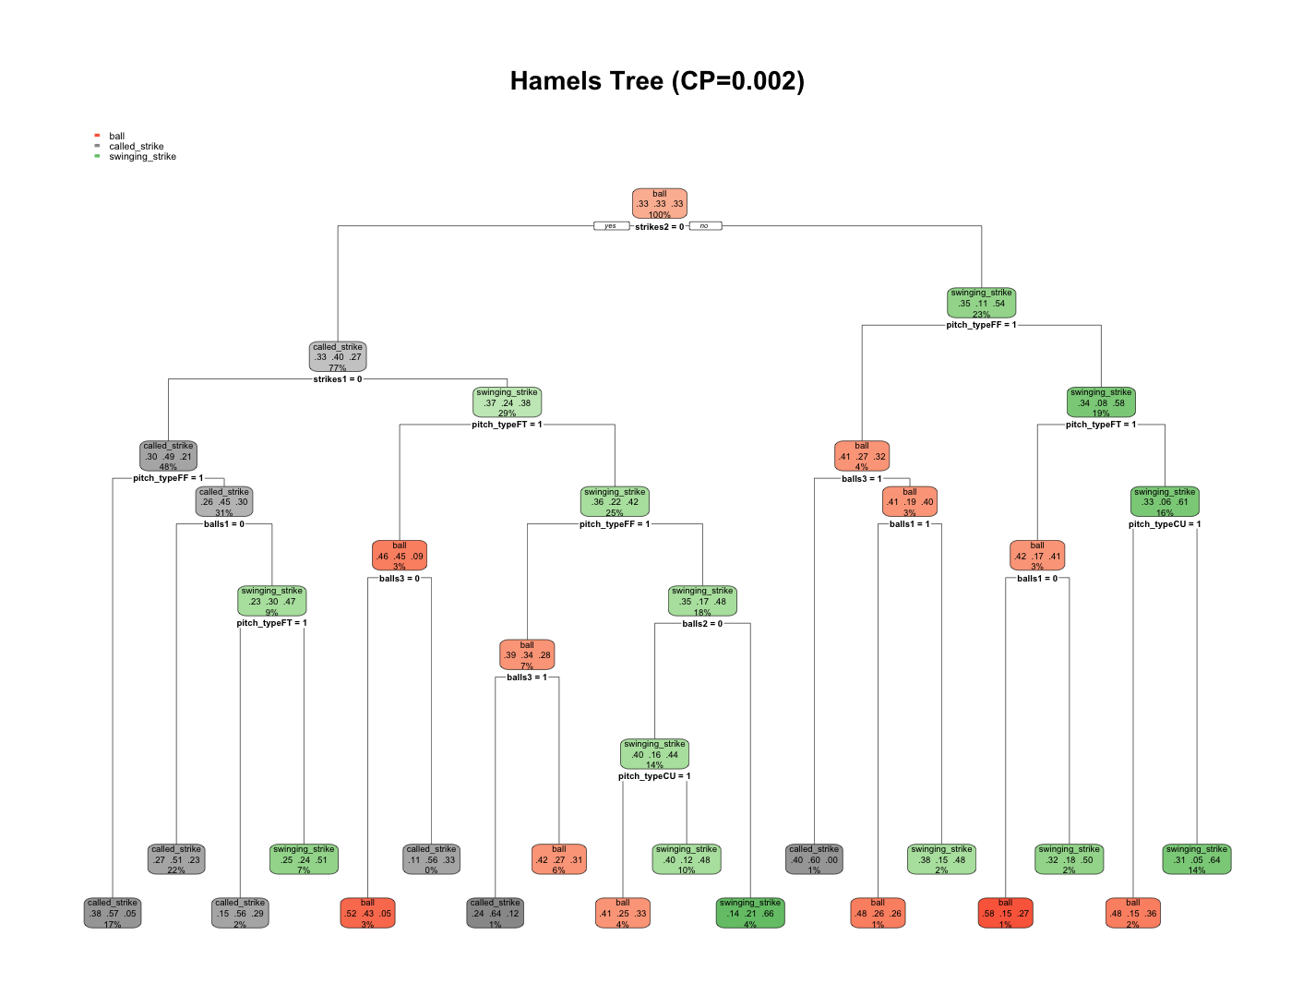

Slide 20
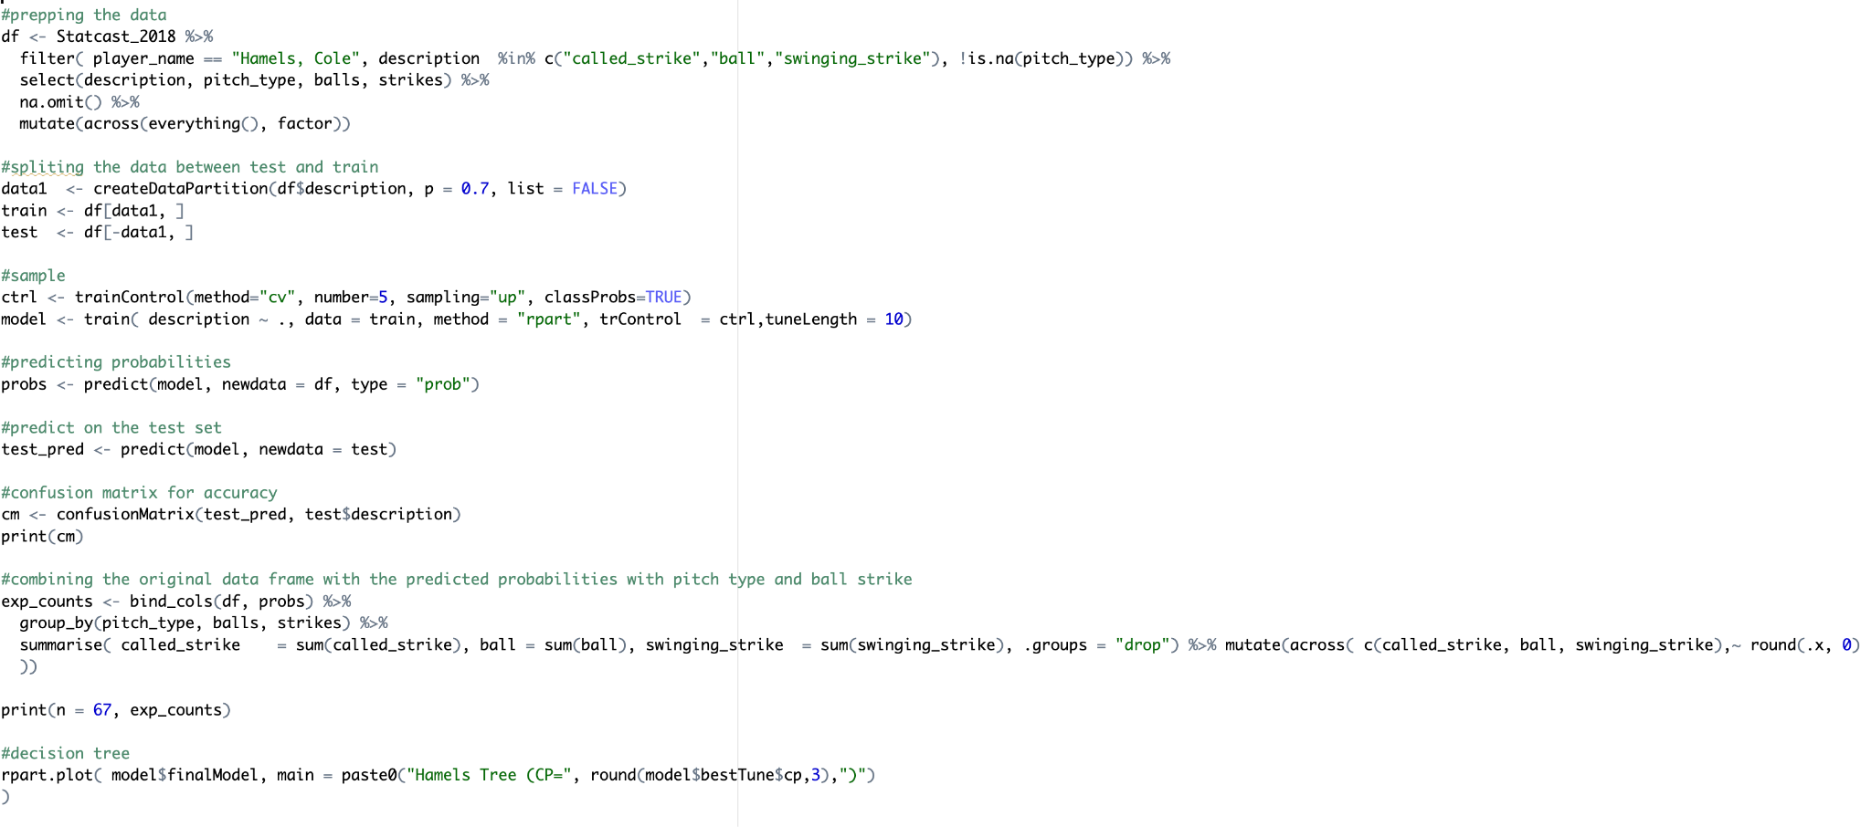

Slide 21
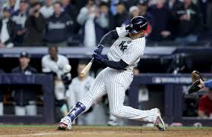
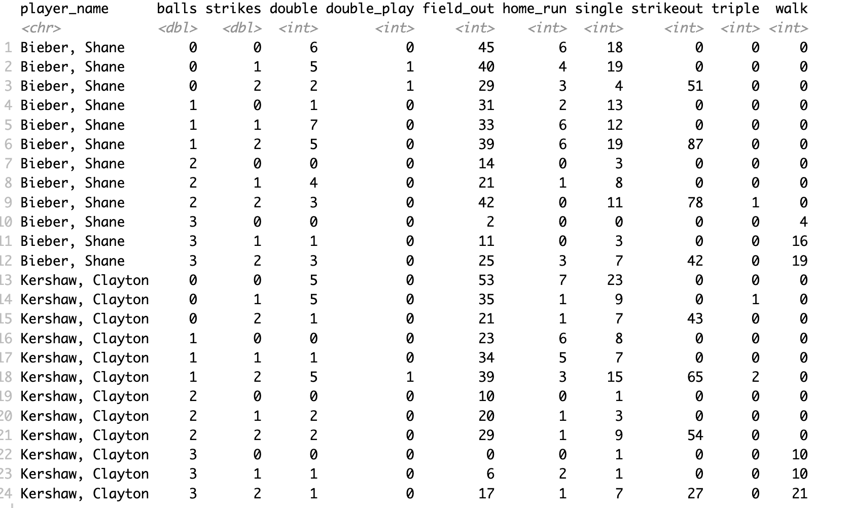
Actual 2019 event data vs Predicted event 2019 Data

Slide 22
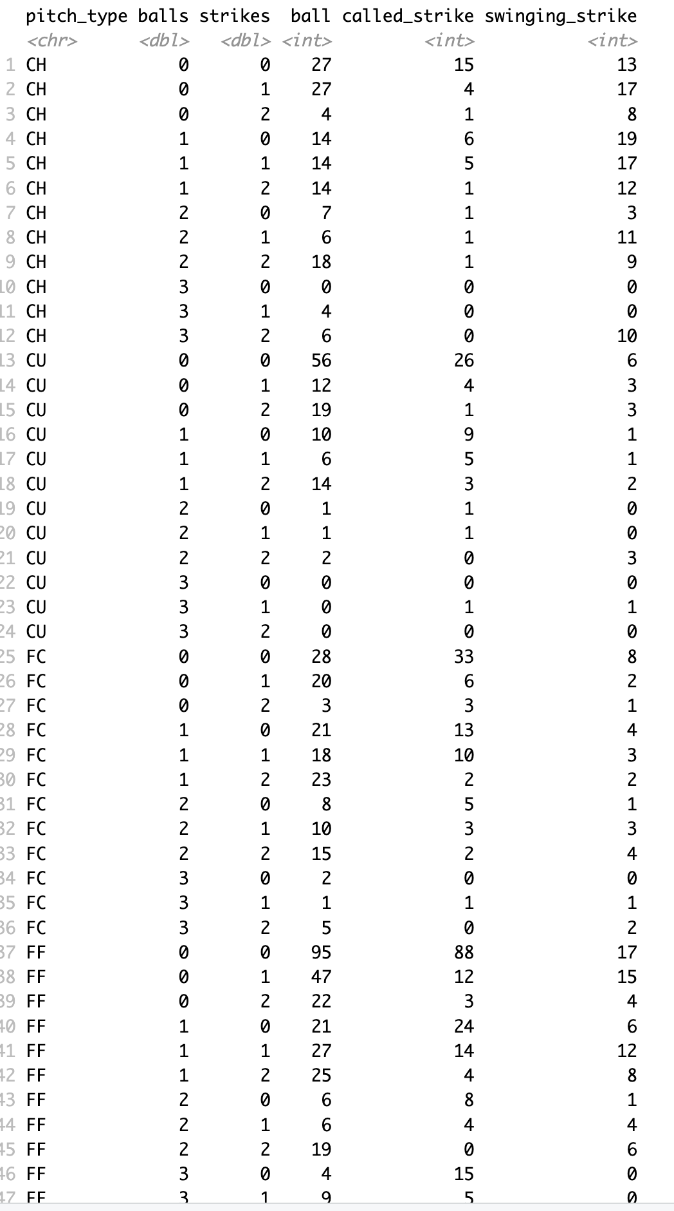
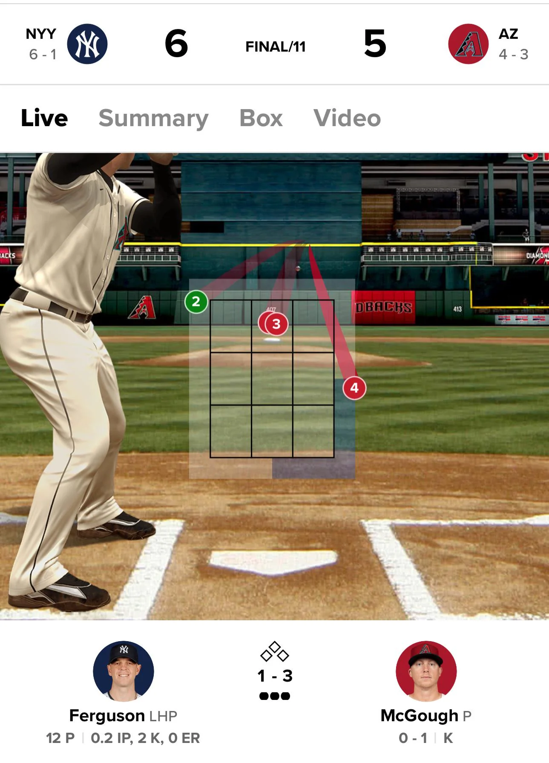
Actual Description 2019 data vs Predicted Description Data

Slide 23


Initial thoughts/
What could be improved?

Slide 24
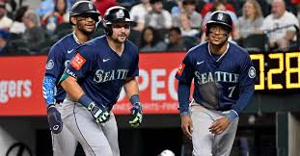
Q/A?

Slide 25
Source: https://www.kaggle.com/datasets/s903124/mlb-statcast-data

